Slide 1
Theory of Computation
Lecture 4
Finite State Automata (FSA)

Slide 2
Syllabus and Terminologies
Regular Languages .. Regular Sets
REs (Regular Expressions)
FSMs (or FSA/FA) … Finite State Machines/Automata
DFA vs. NFA … Deterministic vs. Non-deterministic FSA
Comparison and conversion
Examples & Closure Operations
Pumping Lemma
Context Free Languages
CFGs … Context Free Grammars
PDA … Push Down Automata
Parsing: CFG generating strings vs. PDA recognizing strings
Turing Machine

Slide 3
Finite Automaton
Input
String
Output
“Accept”
or
“Reject”
Finite
Automaton

Slide 4
Finite Automata State Graphs
A state
The start state
An accepting/final state
a
A transition

Slide 5
Transition Graph
initial
state
accepting
state
transition
state

Slide 6
Regular Expressions to Finite Automata
High-level sketch
NFA
Regular
expressions
DFA
Lexical
Specification
Table-driven
Implementation of DFA

Slide 7
Regular Expressions to NFA (1)
For each kind of rexp, define an NFA
Notation: NFA for rexp A
A
For ε
ε
For input a
a

Slide 8
Regular Expressions to NFA (2)
For AB
ε
A
B
For A | B
B
ε
ε
ε
ε
A

Slide 9
Regular Expressions to NFA (3)
For A*
ε
A
ε
ε

Slide 10
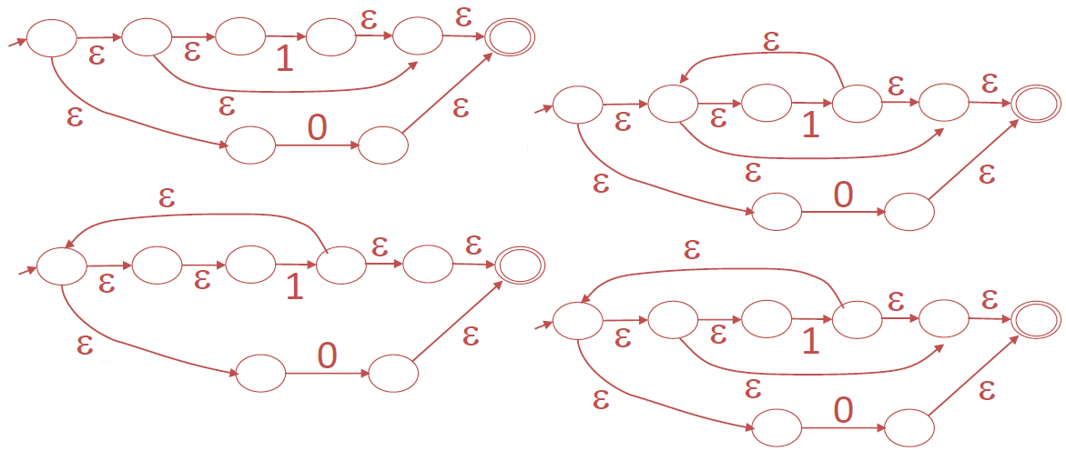
Example of (RE → NFA) conversion
Choose the NFA that accepts the following regular expression: 1* + 0

Slide 11

Example of (RE → NFA) conversion
Consider the regular expression
(1 | 0)*1
The NFA is (there are multiple valid answers)
ε
1
ε
ε
C
E
A
B
1
ε
0
G
H
ε
I
J
ε
D
F
ε
ε

Slide 12
NFA
NFA travels all possible paths, and so it remains in many states at once. As long as at least one of the paths results in an accepting state, the NFA accepts the input.
Alphabet =

Slide 13
NFA
Alphabet =
Two choices

Slide 14
NFA
An NFA accepts a string:
if there is a computation (scenario/path) of the NFA that accepts the string
i.e., all the input string is processed and the automaton is in an accepting state

Slide 15
NFA
An NFA rejects a string:
if there is no computation of the NFA
that accepts the string.
For each computation:
All the input is consumed and the
automaton is in a non final state
OR
The input cannot be consumed

Slide 16
Acceptance Example 1
NFA

Slide 17

NFA

Slide 18
NFA
“accept”
“reject”

Slide 19
NFA
is accepted by the NFA:
“accept”
“reject”
because this
computation
accepts
this computation
is ignored

Slide 20
NFA
is rejected by the NFA:
“reject”
“reject”
All possible computations lead to rejection

Slide 21
NFA
is rejected by the NFA:
“reject”
“reject”
All possible computations lead to rejection

Slide 22
Lambda Transitions
Remember!
Bothe Lambda λ and Epsilon є can be used to represent an empty move

Slide 23
Lambda Transitions
Acceptance Example 2

Slide 24

Lambda Transitions

Slide 25

Lambda Transitions
input tape head does not move

Slide 26
Lambda Transitions
all input is consumed
“accept”
String is accepted

Slide 27
Lambda Transitions
Rejection Example 3

Slide 28

Lambda Transitions

Slide 29
Lambda Transitions
(read head doesn’t move)

Slide 30
Lambda Transitions
Input cannot be consumed
Automaton halts
“reject”
String is rejected

Slide 31
Lambda Transitions
Language accepted:

Slide 32
Example 4
what is the language accepted by this automata?

Slide 35
“accept”

Slide 36
Another String

Slide 38
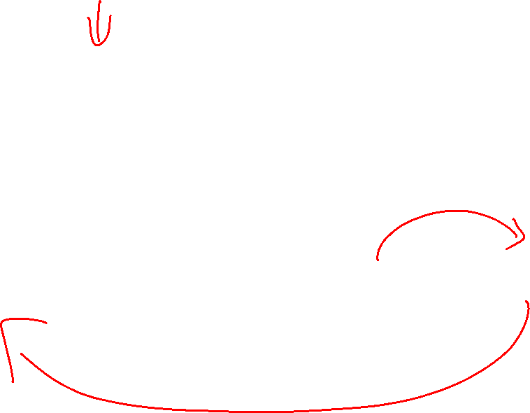

Slide 40


Slide 42
“accept”

Slide 43
Language accepted

Slide 44
Example 5

Slide 45
Language accepted
(redundant
state)

Slide 46
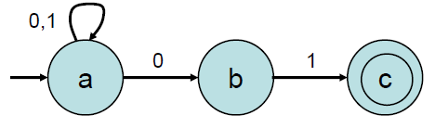
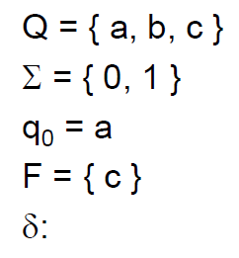
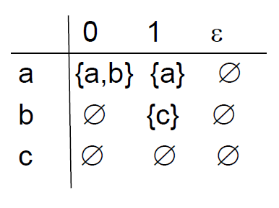
Example

Slide 47
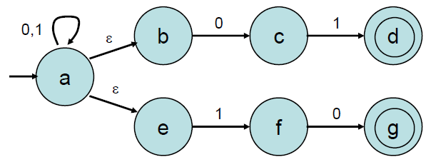
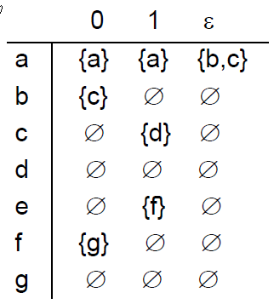
Another Example
Can you gets its corresponding RE?

Slide 48
Extended Transition
Definition: The language accepted by an NFA M = (Q, Σ, δ, q₀, F) is the set of all strings on Σ accepted by M.
Formally,
L(M) = {w ∈ Σ* : δ*(q₀, w) ∩ F ≠ ∅ }
??

Slide 49
Extended Transition
??

Slide 50
Extended Transition
??

Slide 51
Extended Transition
If
??
then

Slide 52
Extended Transition
??

Slide 53
Extended Transition
??

Slide 54
Extended Transition
??

Slide 55
Extended Transition
(
)
=
{
}
*
∪
{
}
∗
{
}
L
M
ab
ab
aa

Slide 56
NFA example: Multiple Paths
b
a
b
q₀
q₁
b
a
q₂
b
b b a b b
b b a b b
q₀ q₀ q₁ q₁ q₂ q₁
q₀ q₁ q₂ q₀ q₀ q₁
q₀ q₁ q₂ q₀ q₀ q₀
q₀ q₁ q₂ q₀ q₁ q₂

Slide 57
Nondeterministic Finite Automata
Definition: The language accepted by a nfa M = (Q, Σ, δ, q₀, F) is the set of all strings on Σ accepted by M. Formally,
L(M) = {w ∈ Σ* : δ*(q₀, w) ∩ F ≠ ∅ }

Slide 58
Deterministic Finite Automata (DFA)
Example:
b
a
1
a
0
3
a, b
a
b
b
2
The above automaton accepts the strings aba, baaabab. However it rejects any string of the form ab^{n}.

Slide 59
DFA
Example
M =({q0, q1, q2}, {0,1}, δ, q0, {q1}),
where δ is
δ(q0, 0) = q0 δ(q0, 1) = q1 δ(q1, 0) = q0
δ(q1, 1) = q2 δ(q2, 0) = q2 δ(q2, 1) = q1
0
0
1
0
q0
q1
q2
1
1

Slide 60
Deterministic finite automata (DFA)
Informally, a deterministic finite automaton over an alphabet Σ can be thought of as a finite directed graph with the property that each node emits one labeled edge for each distinct element of Σ, the nodes are called states. There is one special state called the start or the initial state, and there is at least one final state.
A DFA accepts a string w in Σ* if there is a path from the start state to some final states such that w is the concatenation of the labels on the edges of the path. Otherwise, the DFA rejects w.
The set of all strings accepted by a DFA M is called the language of M and denoted by L(M).

Slide 61
Languages and DFA
The language accepted by a DFA M = (Q, Σ, δ, q0, F) is the set of all strings on Σ accepted by M.
Formally,
L(M) = {w ∈ Σ* : δ*(q0, w) ∈ F}
L(M) = {w ∈ Σ* : δ*(q0, w) ∉ F} non accepted words
where δ* : Q X Σ* → Q is the extended transition function.
The second argument of δ* is a string rather than a single symbol, and its value gives the state the automaton will be in after reading that string.

Slide 62
Examples
What are the languages of these automata?
Σ = {a, b}
q₀
a
b
Σ = {a, b}
b
a
a
q₁
q₃
b
q₀
q₁
a
b
b
a
a
b
b
q₂
q₄
a
0
1
0, 1
q₀
1
q₁
0
q₂
Σ = {0, 1}

Slide 63
Languages and Dfa’s
Example:
a a,b
q₀ b q₁ a, b q₂
trap state
L = { a^{n}b: n >= 0}

Slide 64

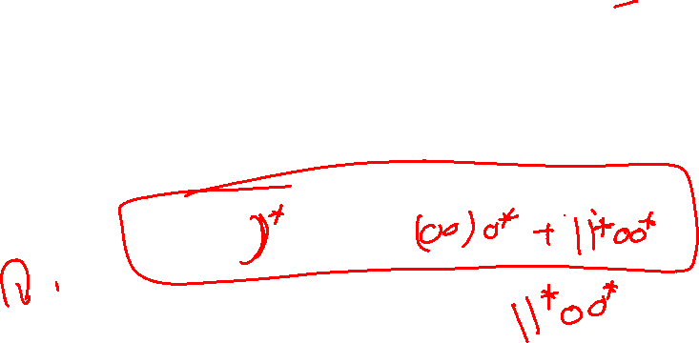
Deterministic Finite Automata
Find a deterministic finite accepter that recognizes the set of all strings on Σ = {a, b} staring with a prefix ab.
a,b
q₀ a q₁ b q₂
b a
q₃ a,b
Find a dfa that accepts all strings on {0, 1}, except those containing the substring 001.
1 0 0,1
1
⋀ 0 0 00 1 001
0

Slide 65
Ex: DFA
All words with even count of letters.
((a+b)(a+b))*
a, b
1±
2
a, b

Slide 66
Ex: DFA
All words that start with “a”
a(a+b)*
b
a,b
2
2
b
1-
1-
3 +
a
3 +
a
a,b
a,b
Does not accept all inputs

Slide 67
Ex: DFA
All words that start with “a”
a(a+b)*
a,b
b
2
1-
a,b
a
a,b
3 +
4+
Special accept state for string “a”, might give better performance in hardware implementation

Slide 68
Ex: DFA (not well defined)
All words that start with triple letter
(aaa+bbb)(a+b)*
a
a
a
2
3
1-
6+
a,b
4
5
b
b
b

Slide 69
NFA vs. DFA
69

Slide 70
NFA and DFA
Example:
The following are NFA and the DFA that describes the same language:
L={(10)^{n} : n≥0}
DFA
NFA

Slide 71
NFA vs. DFA (2)
For a given language the NFA can be simpler than the DFA
1
0
0
NFA
0
1
0
0
0
DFA
1
1
DFA can be exponentially larger than NFA

Slide 72
NFA vs. DFA (1)
NFAs and DFAs recognize the same set of languages (regular languages)
DFAs are easier to implement
There are no choices to consider
However, the NFAs are usually simpler than DFAs
They do not need an edge out of each node for each letter of the alphabet.

Slide 73
Regular Expressions to Finite Automata
High-level sketch
NFA
Regular
expressions
DFA
Lexical
Specification
Table-driven
Implementation of DFA

Slide 74
Regular Expressions to Finite Automata
High-level sketch
NFA
Regular
expressions
DFA
Lexical
Specification
Table-driven
Implementation of DFA

Slide 75
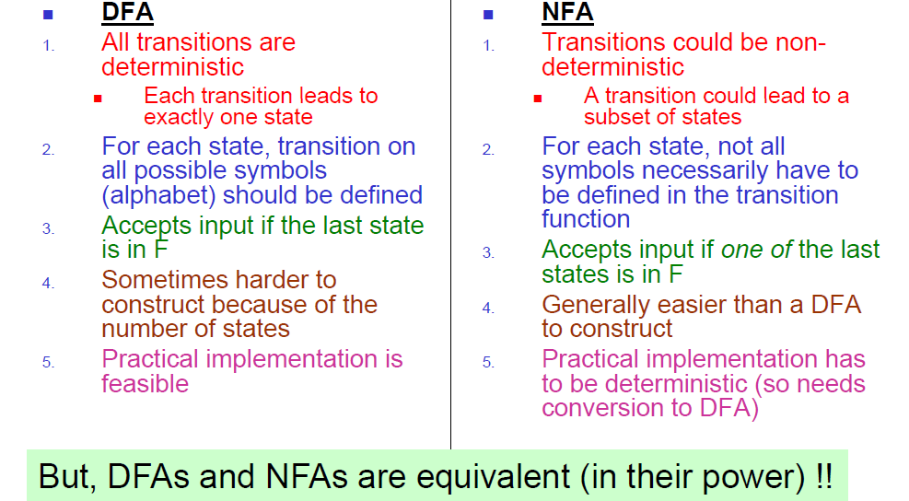
DFA vs. NFA

Slide 76
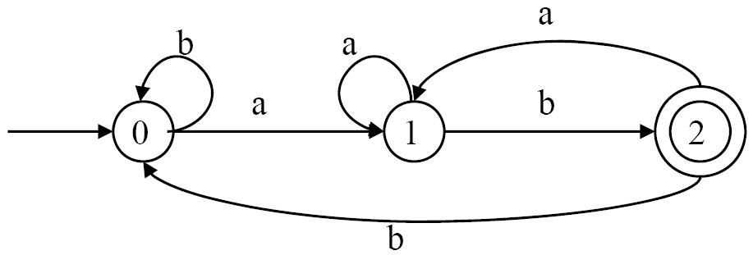
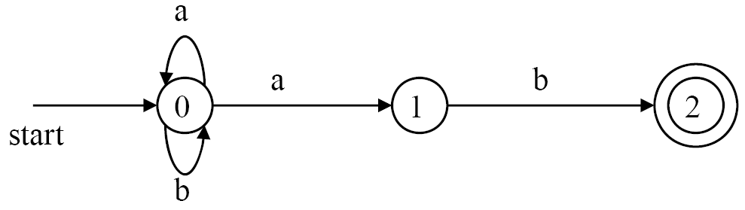
NFA vs. DFA
 | Compactibility | Readability | Speed
NFA | Good | Good | Slow
DFA | Bad | Bad | Fast
DFAs are widely used to build lexical analyzers.
NFA
DFA
The language that recognizes (a+b) * a b
Notes:
NFAs are more compact - they generally require fewer states to recognize a language.
A language defined by an NFA can be easier to understand.
Because an NFA often has more than one next state to move on an input symbol or on ε, its implementation is less straightforward than for a DFA. Thus often it is important to convert an NFA to a DFA that accepts the same language, and use the DFA to build a lexical analyzer.

